Slide 1
Lecture-3 water influx
Water influx definition
Classification of aquifer
Degree of pressure maintenance
Outer boundary conditions
Flow regime
Flow geometry
Water influx models
Pot aquifer
Schilthuis’ steady-state
Hurst’s modified steady-state
The van Everdingen-Hurst unsteady-state
Edge-water drive
Bottom-water drive
The Carter-Tracy unsteady-state
Fetkovich’s method
Radial aquifer
Linear aquifer

Slide 2
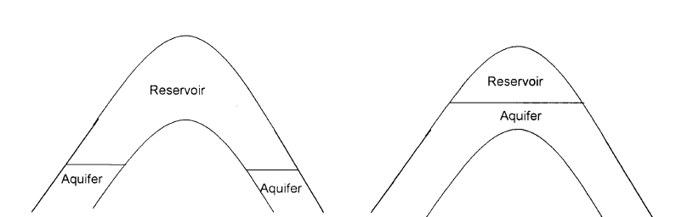
Water influx definition
Water influx: Expantion and flow of water from the aquifer into the oil/gas reservoir caused by the drop in the rservoir pressure, due to the production of fluids. In other word, the hydrocarbon production from the reservoir and subsequent pressure drop prompt a response from the quifer to offset the pressure decline.
Aquifer: Water-bearing rocks surround the hydrocarbon reservoirs.

Slide 3
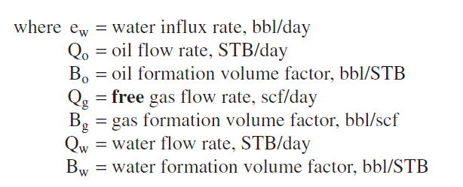
Degree of pressure maintenance
Active water drive
Partial water drive
Limited water drive
Active water drive refers to the water encroachment mechanism in which the rate of water influx equals the reservoir total production rate.

Slide 4
Cumulative production
The gas solubility is substracted from the current gas oil ratio because it is accounted for the oil volume factor Bo

Slide 5
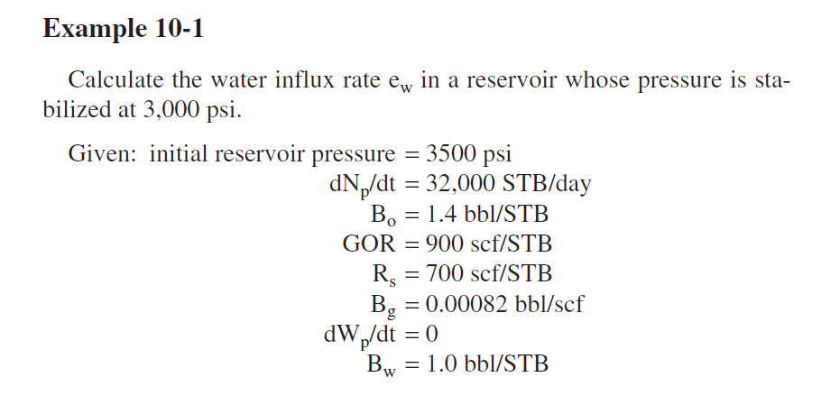
Example-1

Slide 6
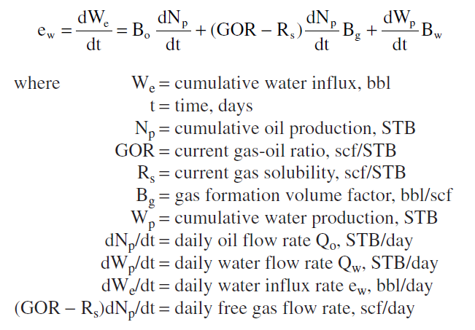
Solution

Slide 7
Outer boundary conditions
Infinite system
The effect of the pressure changes at the oil/aquifer boundary can never be felt at the outer boundary
Finite system
The aquifer outer limit is affected by the influx into the oil zone and that pressure at this limit changes with time

Slide 8
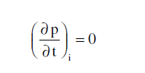
Flow Regimes
Steady-state
Semisteady (pseudosteady)-state
Unsteady-state

Slide 9
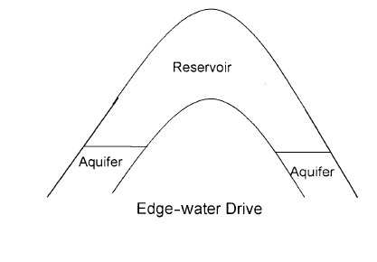
Flow Geometries
Edge-water drive
Water moves into the flanks as a result of pressure drop of the reservoir-aquifer boundary.
Radial flow with negligible vertical flow.

Slide 10
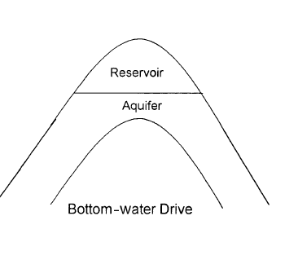
Bottom-water drive
The reservoir water contact completly underlies the reservoir
The flow is essentially radial and in constrast to the edge-water drive
Vertical flow

Slide 11
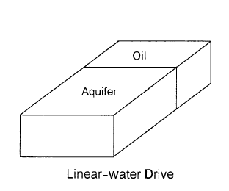
Linear-water drive
The influx is from one flank of the reservoir
Flow is linear with a constant cross-sectional area.

Slide 12
Water influx models
Pot aquifer
This model estimate the water influx into a gas/oil reservoir is based on the basic definition of compressibility

Slide 13
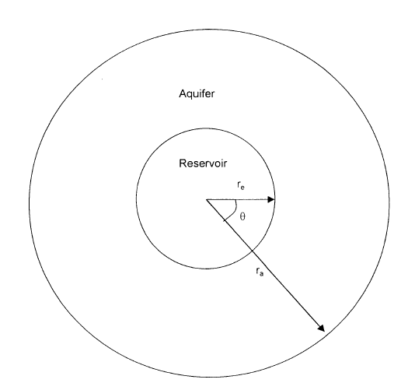
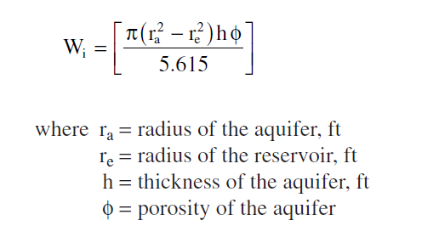
Calculating the initial volume of the water in the aquifer.
Include the fractional encroachment angle f
Since the reservoir is not circular in nature, water does not encroach on all sides of the reservoir.

Slide 14
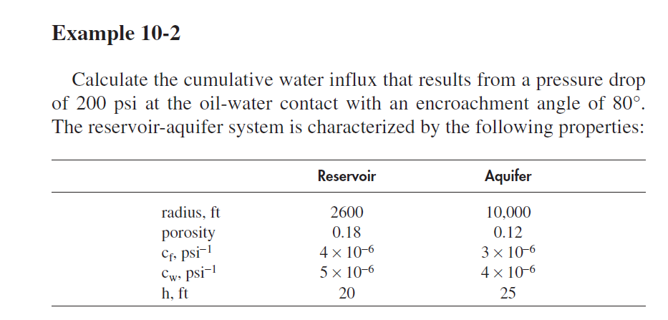

Slide 15
Solution
Calcutation of the initial volume of water (Wi) in the aquifer
Calculate the cumulative water influx

Slide 16
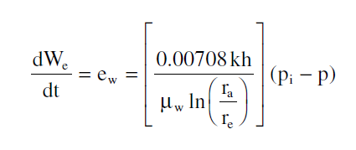
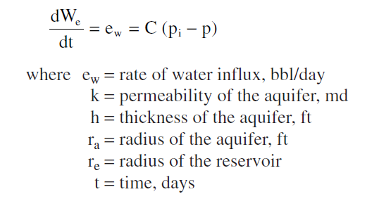
Schilthuis’ Steady-State Model
Darcy’s equation (steady-state flow regime), the rate of water influx
Q: Do you remember where this equation comes from??
Derive it
C: is the water influx constant (bbl/day/psi)
C$=\frac{ΔWe}{Δt(pi−p)}$
Note that B.C.Craft calls it

Slide 17
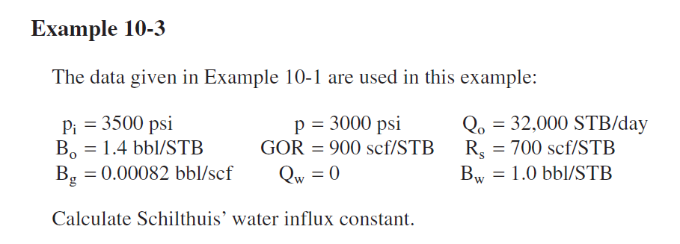
Solution

Slide 18
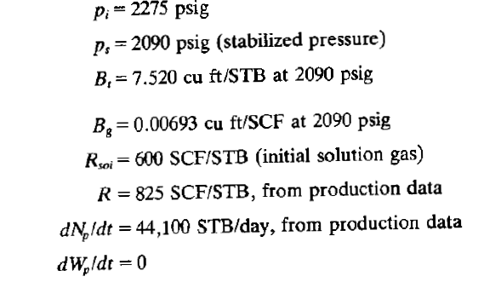
Example 8.1 B.C.Craft

Slide 19
Solution

Slide 20
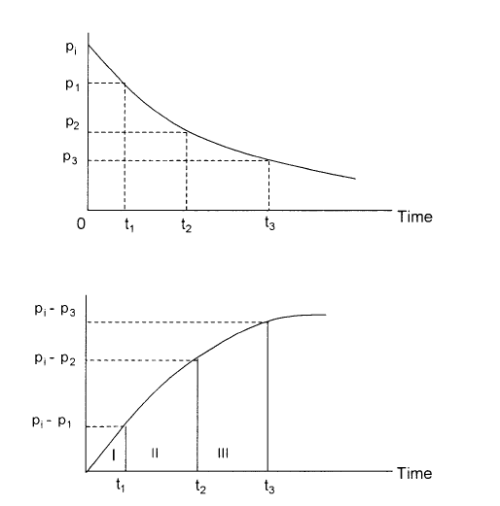
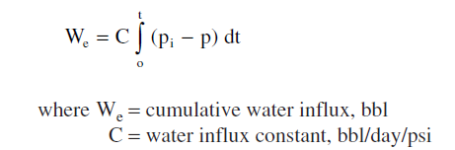

Slide 22
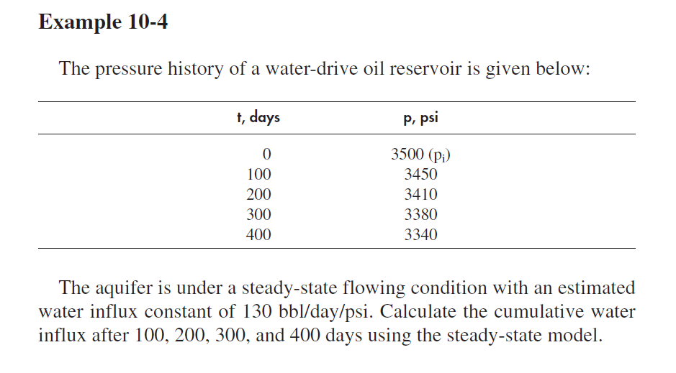

Slide 23
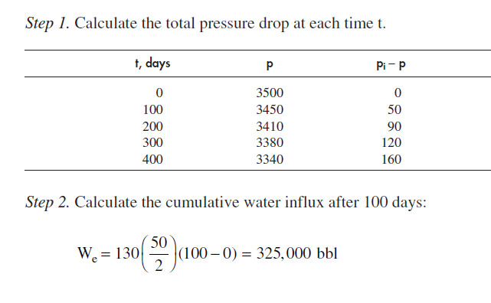
Solution

Slide 24
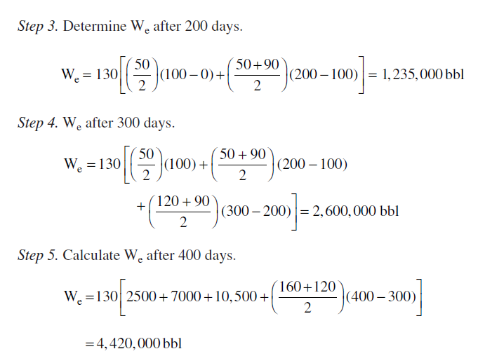
Solution

Slide 25
See you next time
HAVE A NICE TIME

